Slide 1
Cost Affecting Factors
Pricing calculator
Learning Objectives
Cost Reduction Methods - Recommended practices to minimize cost.
Total Cost of Ownership Calculator
Cost Management and Billing tool/service

Slide 2

Cost Affecting Factors

Slide 3
Cost Affecting Factors
Types of Azure Subscription
Free Trial
Pay-as-you-go
Member offers – you get credit and reduced rate
Visual Studio subscribers
Microsoft Partner Network members
Microsoft for Startups members
Microsoft Imagine members
Azure Services purchase options
Through an Enterprise Agreement
Directly from the Azure portal website and pay standard prices
Azure Marketplace - third-party vendors
Through a Cloud Solution Provider (CSP)

Slide 4
Cost Affecting Factors
Resource type
Example: Storage type (block blob storage, table storage, performance tier, access tier)
Usage meters
Microsoft generates meter at the time of resource provision, this meter generates usage record
⮚
⮚
⮚
⮚
⮚
Single VM: CPU time + Public IP address + network traffic (incoming, outgoing) + disk size + disk operations (read, write)
Functions: No of execution + memory/sec
Storage: Storage x tier + Operations
Logic App: Actions
Resource Group: FREE
Resource usage
Example – deallocate VM when not in use, save compute cost but storage will still cost.
Location
Low data center operating cost can reduce your cost
But high network bandwidth can increase cost
Bandwidth - data moving in and out of Azure datacenters

Slide 5

Cost Reduction Methods

Slide 6


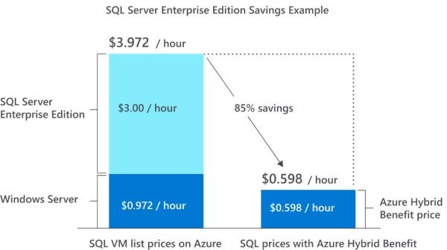
Cost Reduction Methods
Reservations
Reserve resources for 1 year or 3 years in advance.
Azure Reservations can save you up to 72 percent as compared to pay-as-you-go prices.
Save on licensing costs
Choose cost-effective operating systems
Hybrid Benefits
letting you use your on-premises Software Assurance- enabled Windows Server and SQL Server licenses on Azure.
You pay only for the VMs' infrastructure cost

Slide 7













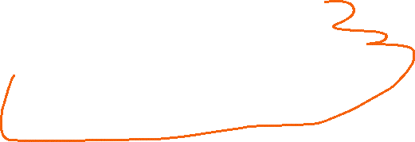






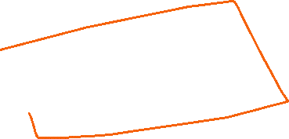
Cost Reduction Methods
Spot VM
Spot pricing provides access to Azure compute resources at deep discounts when unused Azure capacity is available.
If Azure needs the capacity back, spot VMs can be evicted with a 30- second notice.
You can set the maximum price that you agree to pay.
Your VMs are automatically evicted when the current spot price is higher than the maximum price you agree to pay or if Azure no longer has compute capacity available .
Best for interruptible workloads (batch processing, dev/test
environments, non-critical tasks etc.)

Slide 8
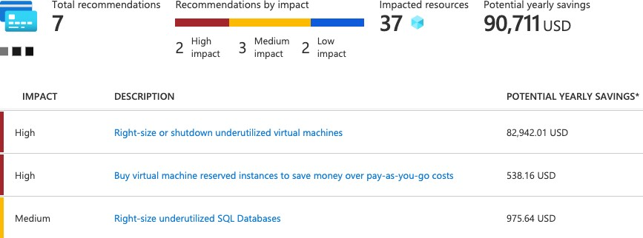
Cost Reduction Methods
Azure Service Advisor
Resize underutilized virtual machines
Deallocate virtual machines during off hours
Delete unused resources
Migrate from IaaS to PaaS services
Choose Low cost Location and Reservation

Slide 9


Total Cost of Ownership (TCO) Calculator
On-premises
Upfront Cost
Capital Expenditure (CapEx)
Hardware costs
Software costs
Electricity costs
Virtualization costs
Data center costs
Networking costs
Database costs
Data warehouse costs
Azure Cloud
Pay-As-You-Go
Operational Expenditure (OpEx)
Estimate the cost savings you can realize by migrating your workloads to Azure

Slide 10

Azure Cost Management and Billing
Manage your cloud spending with confidence

Slide 11
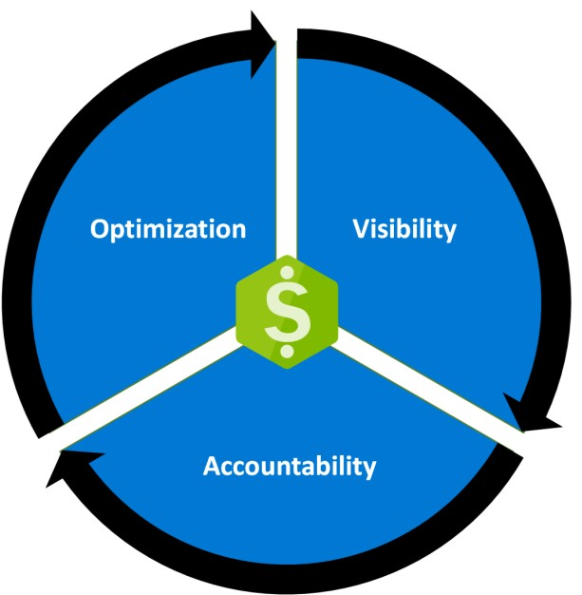
Cost Management
This is a built-in service that gives you a breakdown of the usage and cost of your Azure
resources.
This allows you to see what is costing you money and how it compares against your budget.
⮚
You use Cost Management + Billing features to:
Conduct billing administrative tasks such as paying your bill
Manage billing access to costs
⮚
⮚
⮚
⮚
Download cost and usage data that was used to generate your monthly invoice
Proactively apply data analysis to your costs
Set spending thresholds
Identify opportunities for workload changes that can optimize your spending
Source: Microsoft

Slide 12
Cost Affecting Factors
Types of Azure Subscription
Azure Services purchase options (Direct, Third-party vendors, CSP, Enterprise agreement)
Resource type
Usage meters
Resource usage
Location
Bandwidth
Pricing Calculator - estimate the monthly cost of running your cloud workloads.
Cost Reduction Methods
Learning Outcome
Reservations
Save on licensing cost
Spot VM
Service Advisor
Delete unused resources
Migrate from IaaS to PaaS
Location
Total Cost of Ownership Calculator - compare your current datacenter costs to running the
same workloads on Azure.
Cost Management
What is costing you money and how it compares against your budget
⮚

Slide 13
Governance
The term governance refers to the process of establishing and enforcing rules and policies.
A good governance strategy helps you maintain control over the cloud applications and resources you manage.
Azure Role-based access control (RBAC)
Resource Lock
Learning Objectives
Tags
Azure Policy
Azure Blueprints
Cloud Adoption Framework

